Slide 1
Note for the teachers: In this content , most of the words have been explained in vocab section.
If the teachers who use the content in their own classroom may explain all the words if needed .

Slide 2
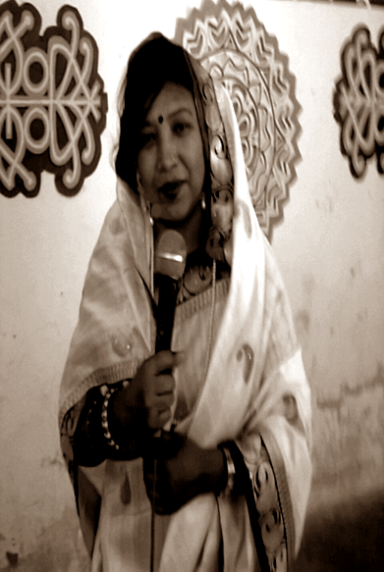




PREPARED &PRESENTED BY:
Dhanmondi, Dhaka-1207

Slide 3


GOOD AFTERNOON
WELCOME TO
ENGLISH 1st PAPER CLASS
CLASS viii
Notes:
UNIT vi,Lesson-3,4,developed for a 50 minute class

Slide 4
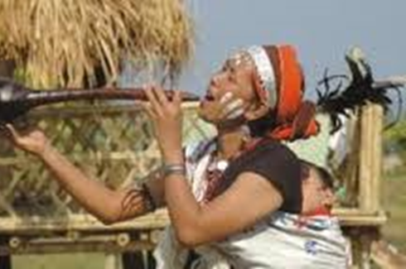
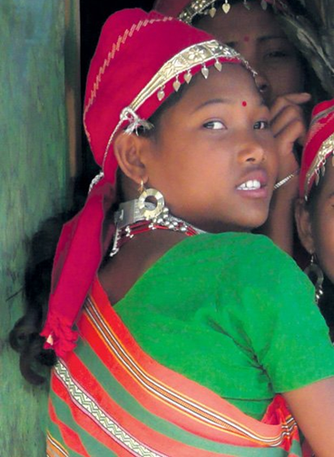
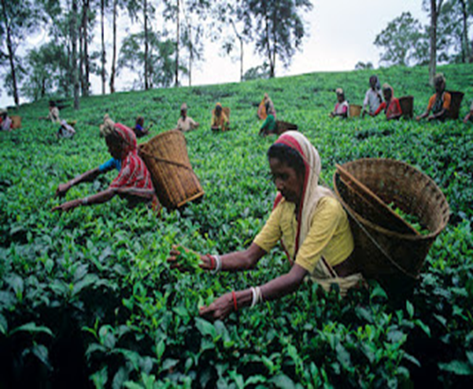
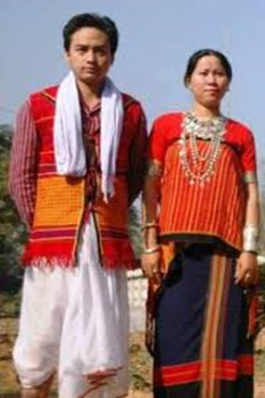

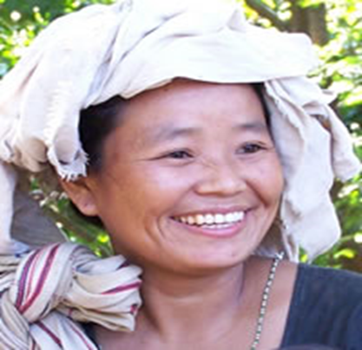
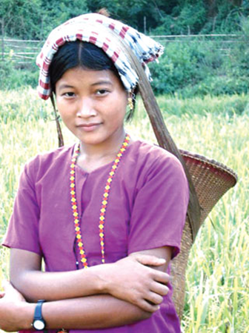
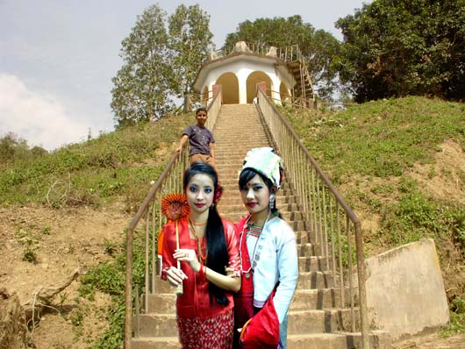










LOOK AT THE PICTURES
KHASIA
RAKHAIN
RAKHAIN
MURONG
Notes:
After the pictures appearance on the screen have completed, the learners will be asked to describe the pictures. Then the teacher will declare the day’s topic.

Slide 5
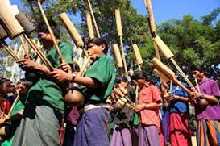
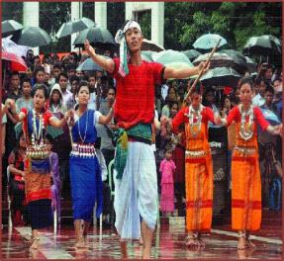
TODAY’S TOPIC
our ethnic friends

Slide 6
LEARNING OUTCOMES
By the end of the lesson the learners will be able to--
describe the ethnic people
guess meaning of the words close to the text
answer the questions about ethnic people
write the activities of the ethnic people

Slide 7
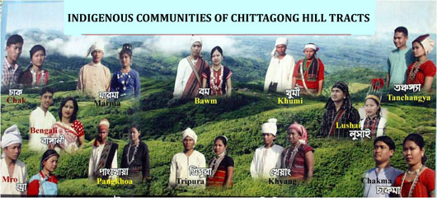
TEXT READING
I will ask the learners to read the text for 10 minutes. After they have finished reading the text, I will give them further tasks on the basis of the given text.

Slide 8
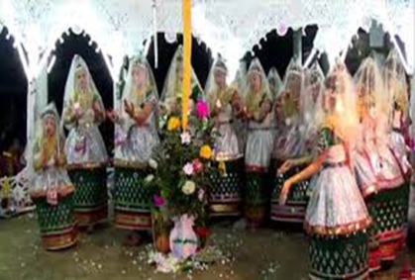
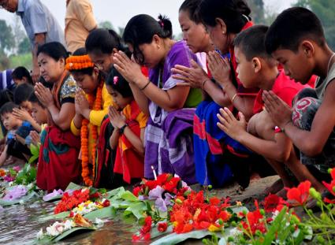
ETHNIC
pertaining to or characteristic of a group of people, especially a group sharing a common and distinctive culture, religion, language, or the like
Ethnic people practise a common and distinctive colourful culture.
Notes:
After the learners have finished reading the text, I will explain the key words and continue the class step by step .grammar will be through continuing the passage.

Slide 9
<iframe width="420" height="315" src="//www.youtube.com/embed/w27HiPcTVhI" frameborder="0" allowfullscreen></
http://youtu.be/ w27HiPcTVhI
Bangladeshi Manipuri daily lifes etc etc
Language:
Ethnic people have their own mother tongue. We don’t understand it. Just to experience a dialog among some ethnic people , lets enjoy a video clip of one of the daily chores of an ethnic group , the Monipuris.please visit the given link.

Slide 10
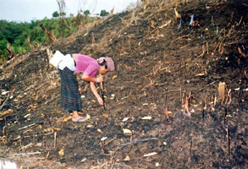
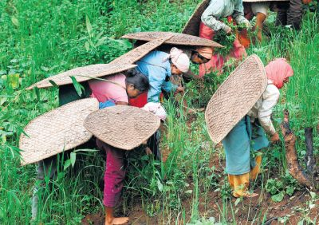
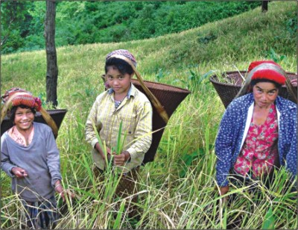
Jhum
Clearing the hill –slopes and the lands in the forests, ethnic people practise cultivation and its called ‘jhum’.
Notes:
Common featurs of the ethnic people

Slide 11
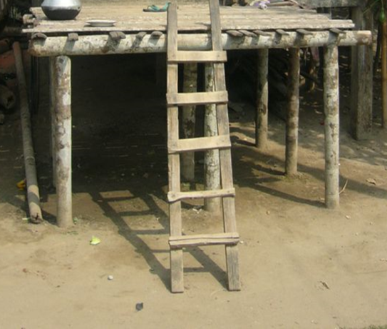
PLATFORM
A place raised high from the ground
Ethnic people build their houses on the high platform to protect them from wild animals.

Slide 12
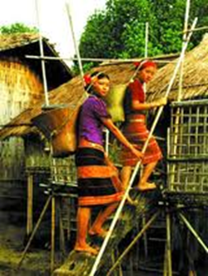
MACHANG
A house built on a high platform
Ethnic people build their houses on the high platform that is called the ‘machang.’

Slide 13
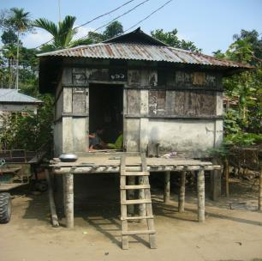
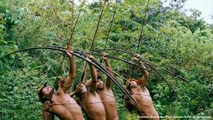
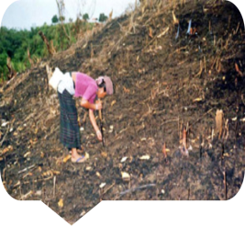
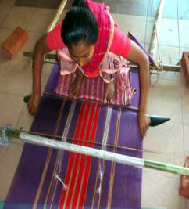

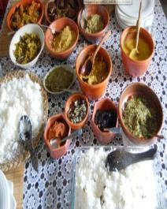
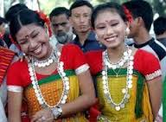
SOME COMMON CHARACTERISTICS OF ETHNIC PEOPLE
JHUM -
AGRICULTURE
HUNTING
MACHANG
WEAVING
LUNGI & THAMI
FOOD- RICE WITH VEGETABLES
HEAVY JUELLERY
Notes:
The learners will be asked to guess the name ,after that the teacher may share the correct ones.

Slide 14
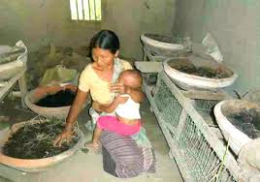
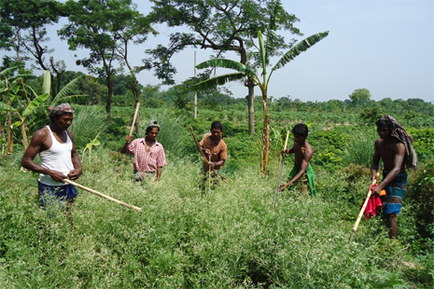
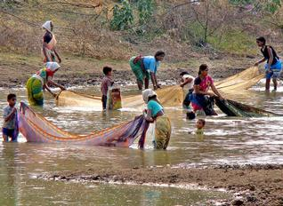



FISHING
POTTERY
HUNTING
OCCUPATION
OCCUPATION
OCCUPATION
JHUM
CULTIVATION
TEA LABOURING
Notes:
The learners will be asked to tell about the occupations of ethnic people.

Slide 15


QUESTION
ITEMS
1.Guess the meaning of the following words close to the text:
i) ethnic-
iii) platform-
a)people living in the forest areas ,
distinct in culture, religious and language-tribes
a) station
b) root people’s subordinate
d) stage
c)rural people
c) track
d)People living in the low lying areas
b)raised surface to build houses
ii) tongue-
iv) characteristic-
a)language
a)feature
c) look
c)utterance
b)speech
b)type
d)quality
d)word
Notes:
In the question paper 7 multiple choice questions/guessing meaning close to the text will be set from the text from EFT.

Slide 16
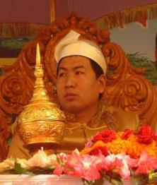
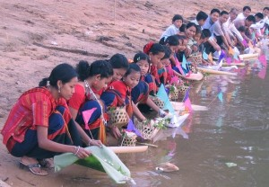
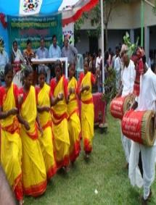

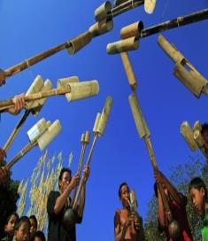
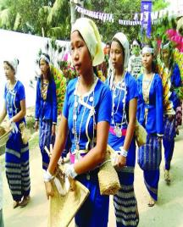

MARMA
PUNNYAH
CHAKMA
BIJHU
SANTAL-NEW YEAR FEST
festivals
MURONG COW-KILLING FEST
MARMA
SANGRAI
MONIPURI
RASH UTSOB

Slide 17
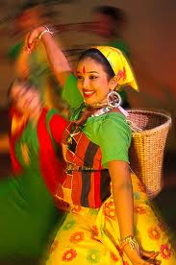
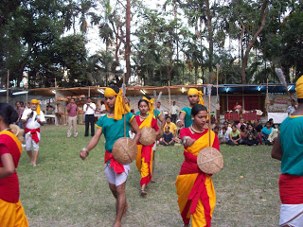
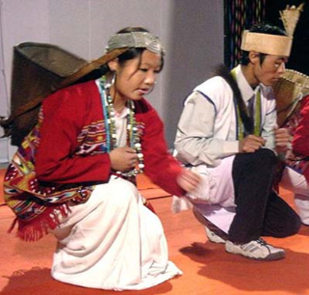
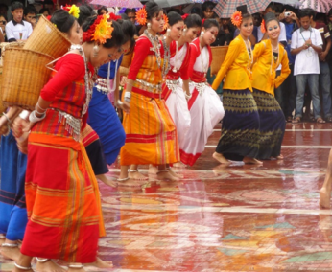
GROUP WORK
Group1, 3,5
Group2,4,6
Notes:
The class will be divided into 6 groups. Each group will be asked to write the activities of the people identifying their community.

Slide 18
QUESTION
ITEMS
2. Answer the following questions in your own words.
a)
Who are our ethnic friends? Why are they considered so?
b)
Are their features the same to us ? What do you think?
c)
How do they pass their leisure ?
d)
How do they do the JHUM CULTIVATION ?
e)
How do they lead their lives?
f)
Describe any group of ethnic people from your reading
in the text?
Notes:
10 answering questions will be set in the question paper from the text of EFT.Iwill ask the learners to raise their hands and invite some of them to write the answers on the black board.

Slide 19
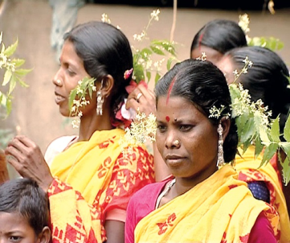
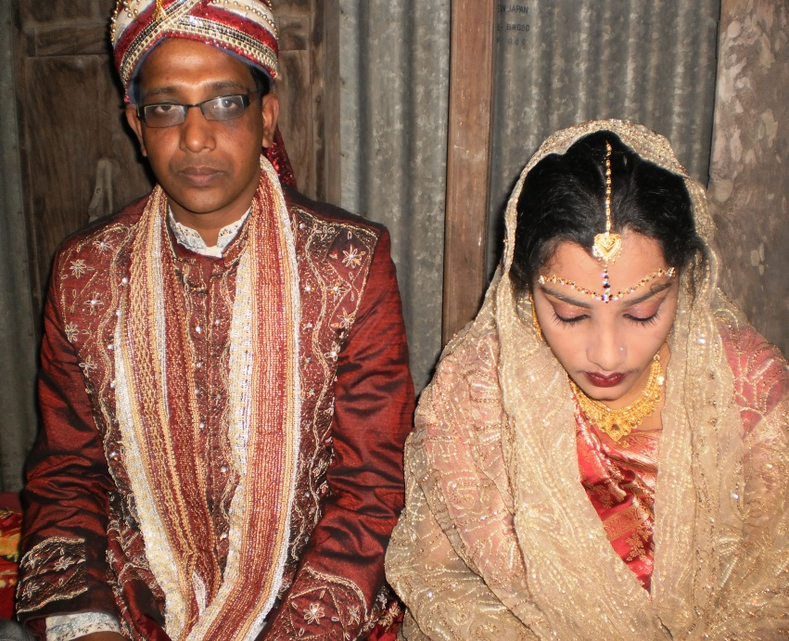
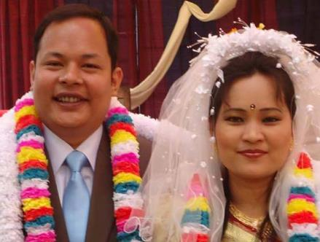
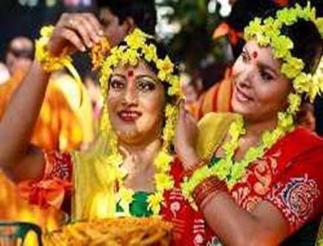
PAIR
WORK
Notes:
The class will be divided into several pairs and then, asked to describe the people & their activities.They will have to find out whether any difference get.

Slide 20
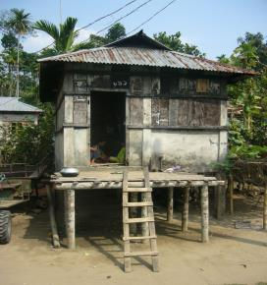
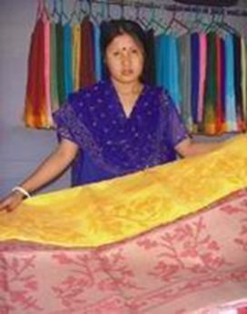
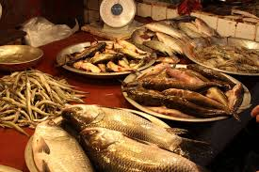
INDIVISUAL WORK
Write a
paragraph
following the
given pictures.
Notes:
The teacher can give instructions how to write a paragraph. Or, 2-3 learners may be invited to say something about the pictures instead.

Slide 21
SUMMING UP THE TEXT & EVALUATION
I will sum up the text . After that I will ask the learners some questions
1. What does the term ‘ethnic’ mean?
2. What is ‘MACHANG’?
3. Why do they build their houses on the high platform?
4. How many ethnic groups have been focused on the
given text ?Which group do you like most?
5.What are the common features the majority ethnic groups have?
6.What are their occupations? What do the most people do?
7. Do they speak in Bangla, the state language among themselves ?
Notes:
Only three items of the questions-guessing meaning of the words , q/a & summarizing from the EFT text will be set in the question paper.

Slide 22
HOME WORK
Write the summary of the text in not more than 40-45 words.
Notes:
The teacher can give instructions how to write a summery. Or, he/she can give any homework from the text.

Slide 23
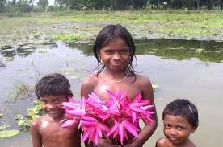
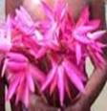
Thank you

Slide 24
Acknowledgement
MoE, DSHE, NCTB & A2I respective officials
And the editors panel:
Mr. Ranjit Poddar, Associate Prof, TTC, Dhaka,
Mr. Md. Jahangir Hasan, Asst. Prof, TTC, Rangpur,
Urmila Khaled Asst. Prof, TTC, Dhaka.
Their direction, valuable suggestions and intensive supervision have enriched the model contents.

